Slide 1
Actual Agenda from a customer
What we are looking at automating:
Automation of setting up new safes from an end-user-requestable way. More insights into how other customers may have accomplished a self-service model would be ideal. We don’t have a very good Role definition at the company, so integrating this into something like IIQ is a future idea, but not realistic in the next several years.
We are also interested in incorporating updates to safes, vaulting additional accounts, adjusting permissions and are curious to hear how others have handled similar asks.
Additionally, we are interested in any insights into ways other customers have used automation tools (ex. Ansible) for things like updating/maintaining/synchronizing/backing up configuration files.
Ways other customers have plugged in to build/onboarding processes for vaulting account types beyond Active Directory (for example, local SQL Server accounts or other databases)
Considerations for deploying the different PAS components to AWS. In particular: guidance on how to keep the AMI’s current (particularly the vault). I’m aware you have several documents / GitHub repos that discuss deploying Core PAS to the cloud, can you share any common pitfalls or things to consider should we move to deploying to the cloud?
Automation tools currently in use:
Currently we have/are finalizing automation for creating a new safe, creating Active Directory accounts and groups, and then vaulting the newly created accounts into the newly created safe (along with triggering a reconcile on the accounts).
We use GitLab pages for the end user information gathering, a Jenkins pipeline to trigger some of our AD Object creation, and PowerShell, along with psPAS for the calls to the CyberArk RestAPI.

Slide 2
Agenda
App support or other internal team members create non-prod and production credentials in respective CyberArk safes
(these safes are access controlled using AD/LDAP groups)
Create necessary automation to create Conjur app/namespace identities, policies, roles and other artifacts to avoid manual steps for the dev and ops team
App team will create a secrets YAML or Helm template and commit to respective application gitops repo
Kubernetes/OpenShift Conjur components will make required API calls to connect to process secret references and add the credentials either to volume and/or as environment variables
write project onboarding automation that creates a safe and grants a ns access to this safe (or do this through manual service now request fulfillment booooo). If possible - integrate with gh actions, give the projects repos access to this safe.
write whatever cluster mechanism is gonna pull the secrets in from conjur and inject into the pods (init containers, controller, side car, etc). This could potentially include a pw change process that restarts the pod

Slide 3
Cyberark Secrets Management
Centralized application access management at scale

Slide 4
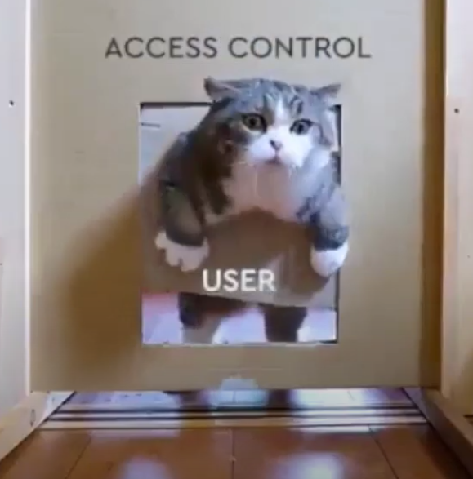

Everybody wants a secure DevOps workflow, but…
Developers
Security
Good USER EXPERIENCE IS IMPORTANT!
So is collaboration!
Notes:
Everybpdy loves cat videos
https://www.youtube.com/watch?v=84gvEKJiJzc

Slide 5

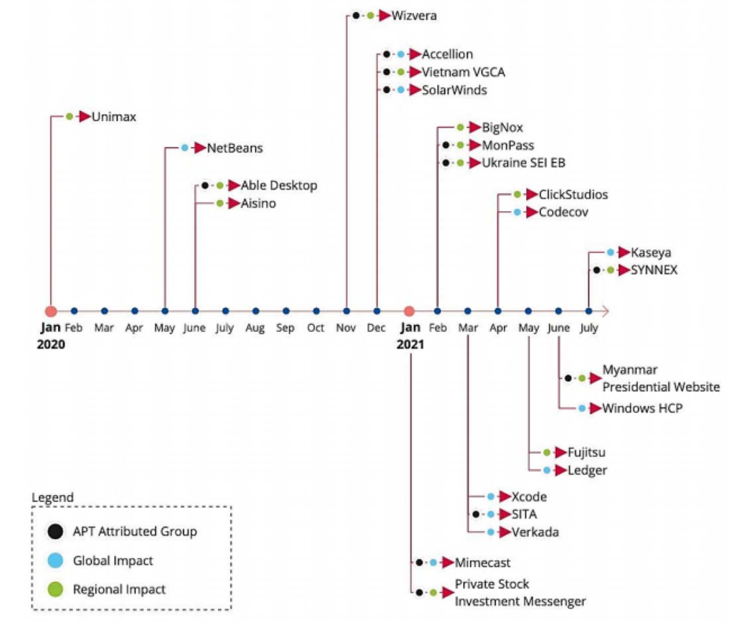

The state of Software Supply Chain Attacks
15%
Of organizations experienced an attack on their software supply chain in 2021
3 times
As many will experience these attacks by 2025
66%
Of attacks in 2020-2021 compromised code
Millions
Of organizations affected
Gartner, How SW engineering leaders can mitigate software… 15 July 2021
ENISA, Threat Landscape of Software Supply Chain attacks, July 2021

Slide 6

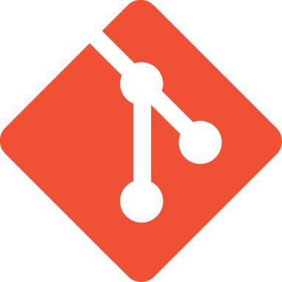



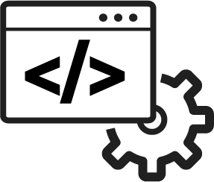






Software Supply Chain – The Risks
Exposed Credentials
Code Injection
Malicious Use of Interactive Access
Code Theft
Code Tampering
Compromised OSS
Exposed Credentials
Injected Malware
Stolen Access Keys
Hijacked Compute/Resources
Exposed Data
Stolen IP
Exposed Credentials
Injected Code, Artifacts, Malware
Rogue Scripts
Build
Test/Provision
Run /Operate
Open Source
Git
Code
CI/CD Tools
Artifact Repo
Automation
Containers
Hybrid
Native Cloud
Weak authentication
Authentication fatigue
Lack of credential rotation
Lack of audit
Over-permissioning
Local admin rights
Credential theft risk
High variability of unknown applications
Relaxed security policy
Developer
Identity/Access
Endpoint

Slide 7



Useful Concepts
SEP Risk Assessment Model
Segregation of Duties
Least Privilege
Risk = Severity x Exposure x Probability (R = S x E x P)
An internal control designed to prevent error and fraud by ensuring that at least two individuals are responsible for the separate parts of any task.
Only the minimum necessary rights should be assigned to a subject that requests access to a resource and should be in effect for the shortest duration necessary.
Notes:
Severity: Describes the potential loss or consequence or a mishap.
Exposure: The amount of time, number of cycles, number of people and resources (equipment) involved.
Probability: The likelihood that given the Exposure, the projected consequences will occur. Training, situational awareness, morale and attitude change are used to mitigate Probability.

Slide 8
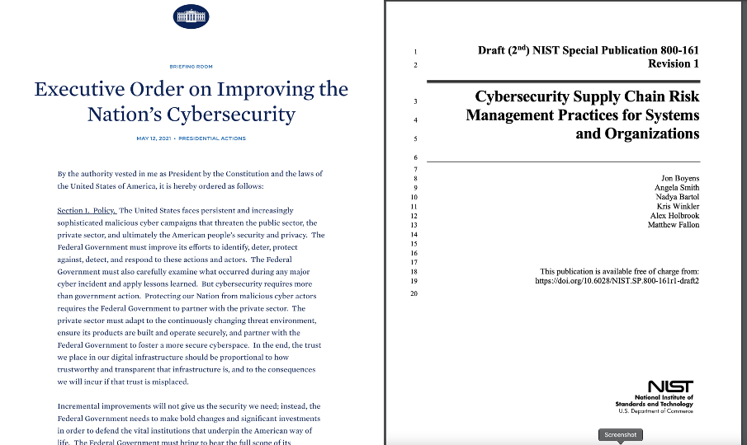
NIST 800-161 Control Mappings
Identification and Authentication
Access Control
Audit and Accountability
Notes:
Before we move on to our use case example, and talk track for CI/CD pipelines, let’s look at the NIST SP 800-53 controls that we will be helping with today.
Access Control:
Provide a way to authenticate and authorize workloads only to the credentials they need while protecting the credential from falling into the hands of humans
Auditing and Accountability
Logging credential retrieval by both humans, as well as non-human identities
Identification and Authentication
Providing the ability to identify and authenticate workloads using modern platforms such as cloud and platform architecture, or using token authentication.

Slide 9
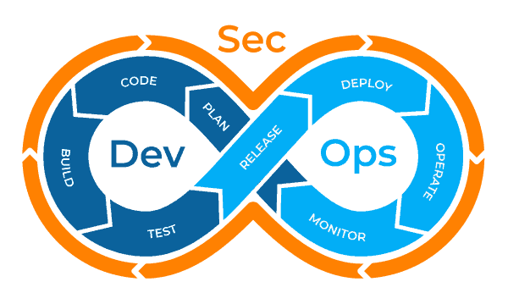
DevSecOps Integrated
Notes:
There are many graphics that you may find when doing a Google search for devsecops, but this is my favorite, because it really shows the need for security to be involved in the entire process.
“Security at Inception”:
Will deliver more secure code
Reduce the amount of time required to respond to incidents
Reduce the amount of time spent refactoring code due to security requirements
Reduce or eliminate the amount of time spent pushing new copies of secrets manually to disparate credential stores
All of this recovered time can be spent providing more value to your end customers, regardless of if that is the American public, or the Warfighters that you support.
DevSecOps takes DevOps one step further, it integrates security into the entire process of DevOps
Each of the steps that were described before, building, testing, releasing all require some level of privilege.
Your Ansible Playbook requires privilege to:
Update the system
Patch the systems
Copy/release/reinstall code
Build infrastructure
Your testing tool requires privilege to:
Login to the test environment
Run tests with the code
Your Ci/Build tools require privilege to:
Build the code
Deploy the code

Slide 10
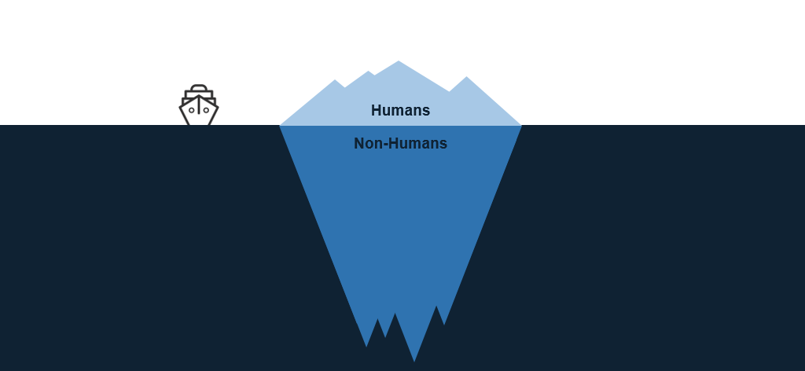
Human Access vs. Non-Human Access

Slide 11
Secrets management Operational objectives
Autonomy
Empower users
Efficiency
Automated (mostly)
Role Separation
Approvals
Account creation
Identity creation
Permission grants
Self-service
Secure
Scalable
Expeditious
Low-maintenance
Enable productivity
Delegate admin responsibilities

Slide 12
Abstract Workflow
Access request is submitted by Project
Access request is approved
Access request is processed
Access request status & results sent to Project
IGA/GRC forensics recorded throughout

Slide 13



Self-Serve Provisioning Architecture
CyberArk
Vault
1) Get admin creds w/ CP/CCP
Orchestration
Provisioning Engine
User submits access request
2) PVWA REST Calls
Feedback Channel
Provisioning Engine options:
Service-Now
IGA Solution (Sailpoint, ForgeRock, Savyint, RSA, etc.)
Clango Embark
Refactr workflow
DevOps automation (Ansible, Jenkins, etc.)
Custom application (Java, .Net, Go, etc.)
Scripts
anything that can make REST calls
3) Conjur REST Calls

Slide 14



Separation of Concerns
CyberArk
Vault
Security Admins
Secrets mgmt
Creation
Rotation
Rotation Protocols
CyberArk
Secrets Management
Target Systems
Databases
Servers
Network Equipment
Project Admins
App policies
Identities
Permissions
Access Protocols
Source Code Mgmt
CI-CD Tools / Applications
App Devs

Slide 15
Oversight should increase closer to production
Requests Auto-Approved
Access Provisioning triggered automatically
Secrets could be managed by Project Teams
Access Provisioning requires approvals
Secrets managed by the Security team
Dev
Test
Prod

Slide 16
Guidelines
99.999% of secrets access is read-only
A “Project”:
Is an operational group of humans (app team, CI/CD admin group)
PLUS:
The apps they build and deploy
Associated CI/CD processes
Associated deployment platform resources (servers, k8s clusters, cloud accounts)
All associated credentials/secrets.
Corresponds to one or more Safes in the CyberArk Vault
Provides a scope for non-human identities (all non-human identities belong to a project)
Has a designated person and/or process acting in a Project admin role.
Vault Safes are ALWAYS and ONLY EVER created by Vault admin processes.
Only Vault or Project admin processes have CRUD privileges on secrets.
CI/CD tools & deployed apps can only read secrets.

Slide 17
Three operational reference models
Synced to Conjur
Only in core Vault
Security-Owned
Collaborative
Project-Owned
SecretsSafe
AdminSafe
DBA creds
API keys
Certs
SecretsSafe
AdminSafe
DBA creds
API keys
Certs
SecretsSafe
AdminSafe (not synced)
DBA creds
API keys
Certs
Security provisions everything
Gives Project team names of identities, Conjur variables.
Credentials for Identity authentication are stored in AdminSafe for Project Admin to distribute.
Example: Big US insurance co.
Security provisions safes & accounts, grants limited safe admin creds to Project Admin role
Project Admin role creates app identities & grants permissions to Conjur hosts/groups
Project Admin role stores identity authn creds in AdminSafe
Example: CYBR PS team
Security only provisions safes, grants safe admin creds to Project Admin role
Project Admin role provisions accounts, creates app identities & grants permissions to Conjur hosts/groups
Project Admin role stores identity authn creds in AdminSafe
Example: Big Euro bank

Slide 18
Customer Examples

Slide 19
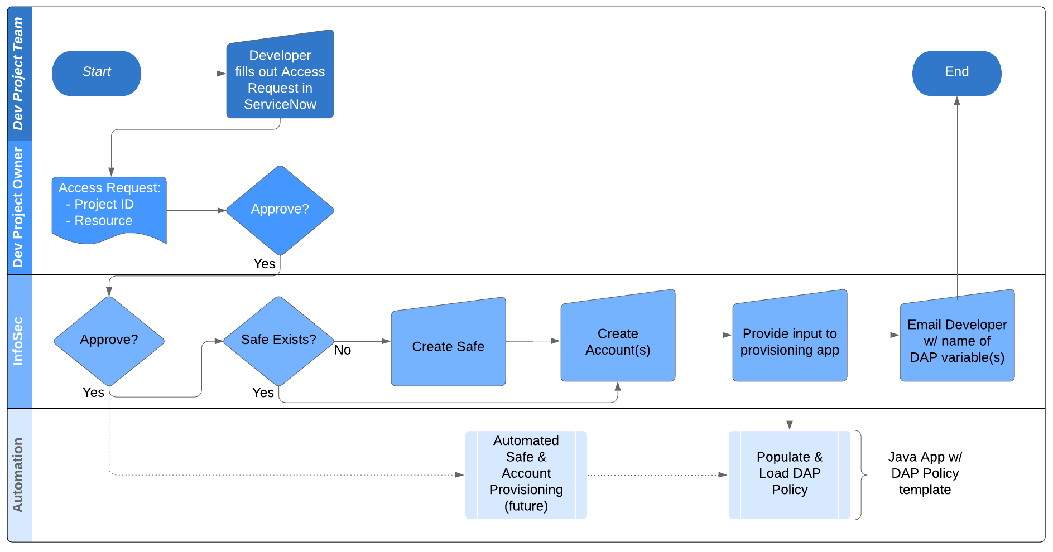
Big insurance company: OpenShift app access workflow

Slide 20
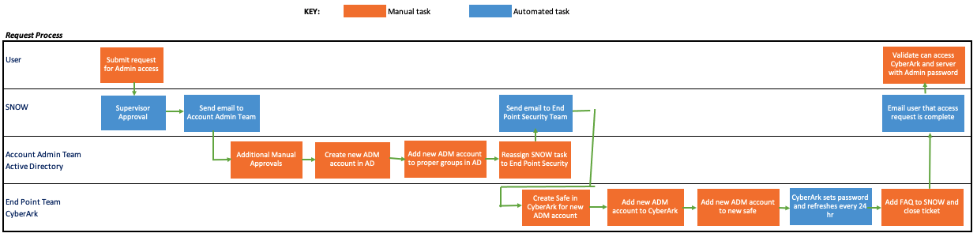
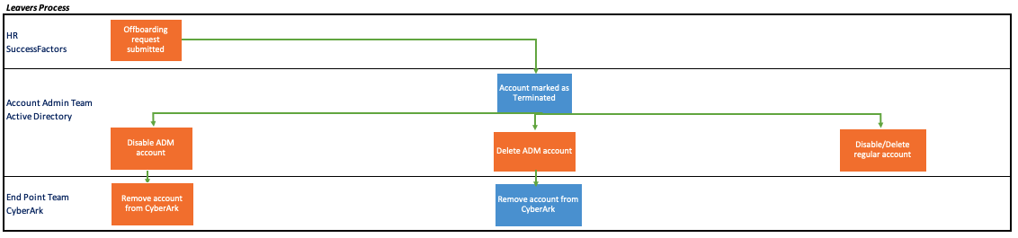
Manufacturing Company

Slide 21
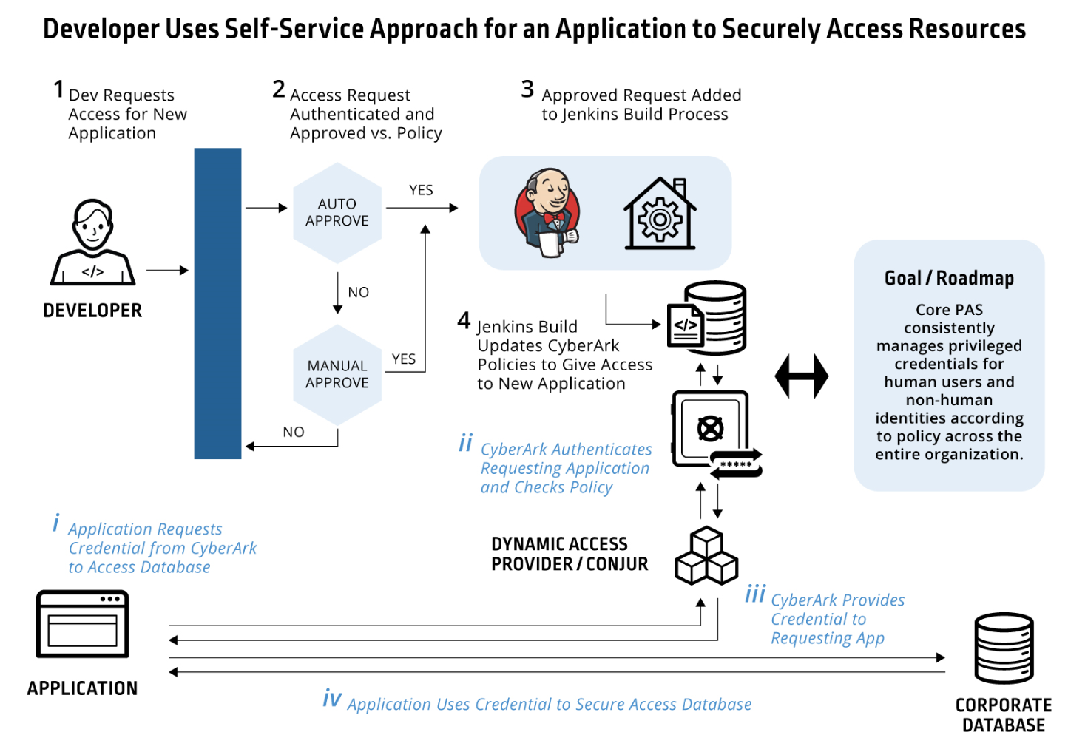

Leading Big Box Retailer
Security works with developers on self-service for secure app access to databases
Objective
Shrink attack surface and meet rigorous audit requirements imposed after prior breach
Establish an enterprise-wide solution for human and non-human credentials
Enable lean security team’s approval process to scale for thousands of developers
Approach
Enable self-service provisioning for typical requests and route exceptions to the security team.
Automatically update secrets manager policies to give apps secure access to resources
Leverage PAM to protect human credentials
Result/Outcome
Successfully rolling out across org.
CONJUR SECRETS
MANAGER
Notes:
This customer, a leading retailer wanted developers to easily allow their in-house developed applications to securely access to databases and other protected resources.
Security was a critical priority for this customer, a few years earlier the company had suffered a breach and had since worked to shrink the attack surface and impose rigorous audit and security requirements. But, rapidly getting new functions and apps deployed to thousands of stores was also critical as the business operated in a highly competitive market. So while the security team obviously wanted to avoid developers hardcoding credentials in apps or using other in-secure practices, at the same time the security team recognized that the business could not afford to slow down deployment of new retail apps and services.
Scale was also a major challenge facing the security team – the organization had thousands of developers and a very small security team. The security team recognized it was essential that any approval process did not become a roadblock for developers.
So the security team established a self-service solution which automated approval requests from developers and only routed exceptions to the security team. Developers simply request approval for the application to access specific databases. Once approved the system, uses a Jenkins build pipeline to automatically update the AAM DAP policy files. So now when applications request credentials from DAP to access the requested resource, the request is approved based on the updated DAP policy.
The solution went into production in 2019 and is being scaled to handle the thousands of applications used by the retailer.

Slide 22
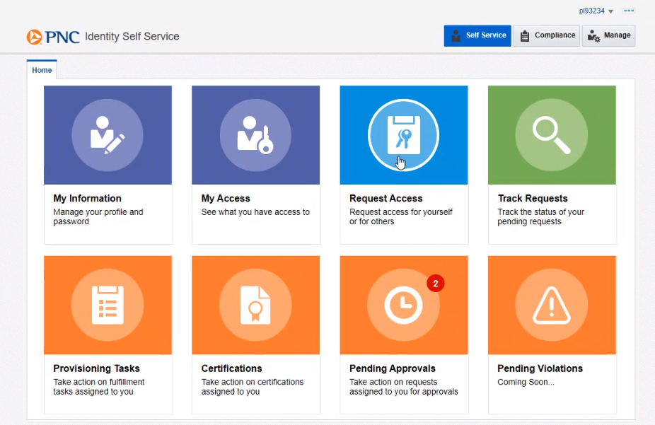
Large bank: Self Service Portal

Slide 23
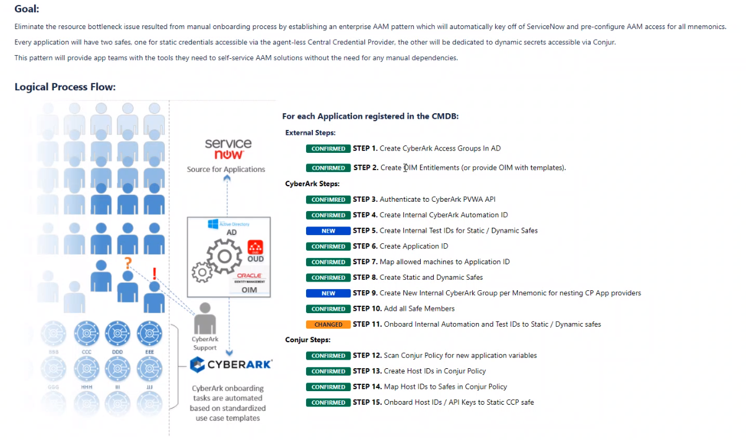
Large bank: Solution Overview

Slide 24
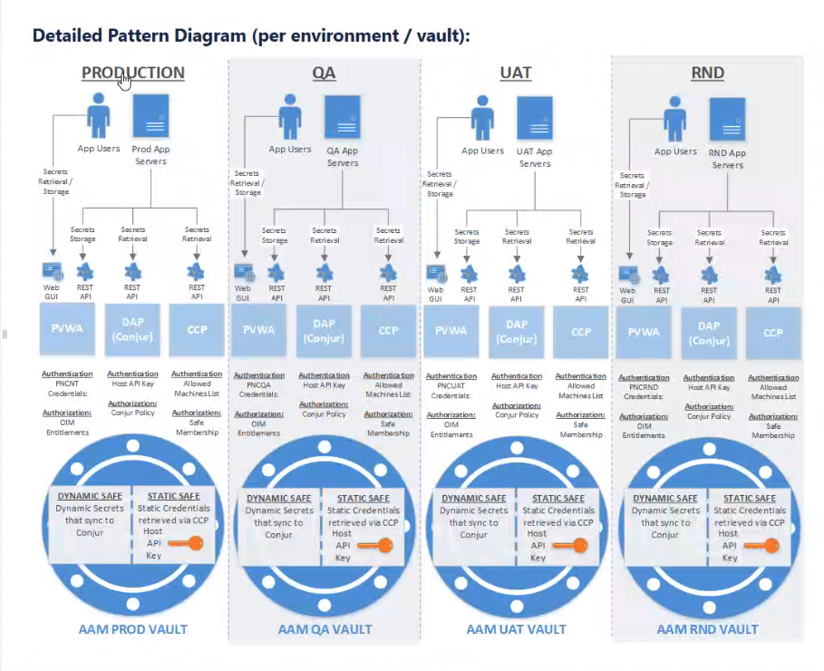
Large bank: A vault for each environment

Slide 25
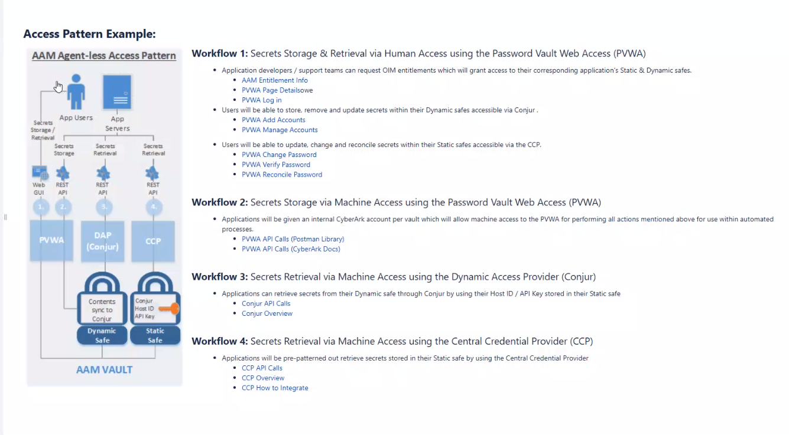
Large bank: Workflows

Slide 26
Demo

Slide 27
Solution values
Code
CI/CD
Production
On prem or cloud
Easy to use
Open RestAPI
Transparent to apps
Out of the box plugins
Jenkins,
GitLab,
Ansible,
Terraform,
and more ….
Cloud authenticators
Autoscaling/HA solution
Native integrations with K8s and OpenShift
Self service automation
Value to the organization:
Efficiency – Rapid access provisioning
Minimal code changes required
Consistent with cloud user experience
Separates concerns – DevOps vs. Security
Meets security compliance requirements

Slide 28
Resources
Joe Garcia’s CybrCLI, a “Swiss Army knife” CLI for PVWA, Conjur, CCP and CEM REST APIs:
https://github.com/infamousjoeg/cybr-cli
PSPete’s Github repos, mostly PowerShell
https://github.com/pspete?tab=repositories
V2 Self-Serve project onboarding using Bash scripts to drive the PVWA and Conjur REST APIs:
https://github.com/conjurdemos/self-serve-onboarding
V3 Safe Access Request approval workflow in Java w/ Python tkinter UI:
https://github.com/conjurdemos/v3-self-server
https://github.com/conjurdemos/v3-self-server-ui

Slide 29
Thank you!

